Slide 1
200 mV (Slides 2-6)

Slide 2
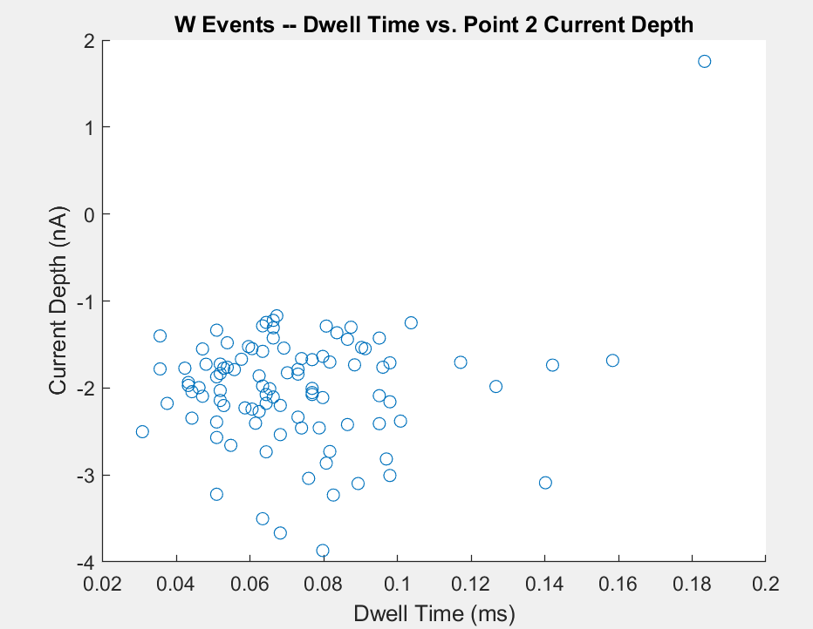
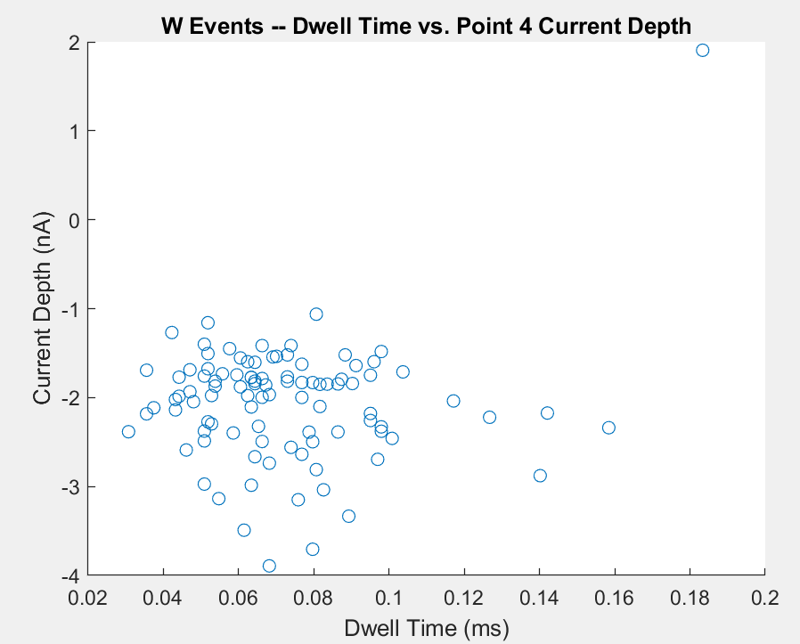
W event 1-5 dwell time vs. W2 current depth and 1-5 dwell time vs. W4 current depth
(pretty much the same current depths)

Slide 3
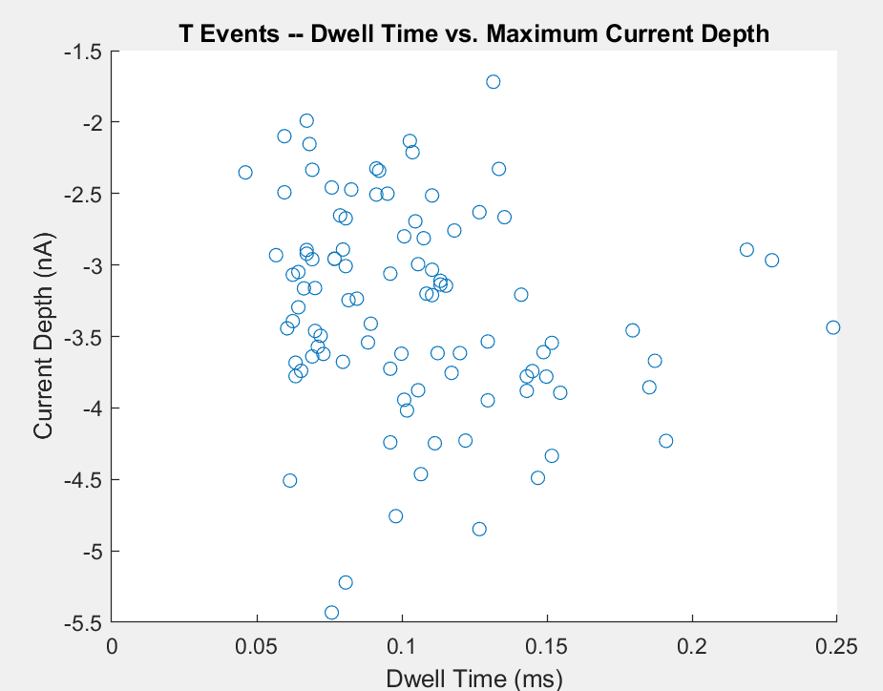
T event 1-5 dwell time vs. T3 current depth
Pretty large current depth spread—this is even after I subtracted all the points by the depth of point 1 (the baseline).

Slide 4
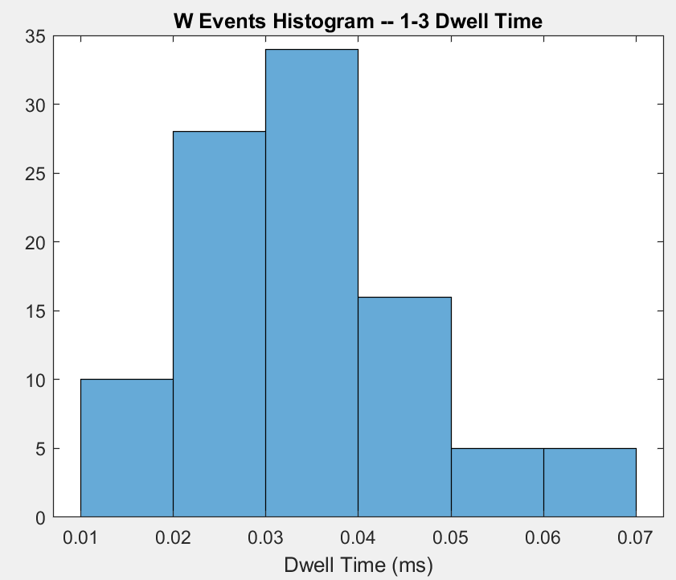
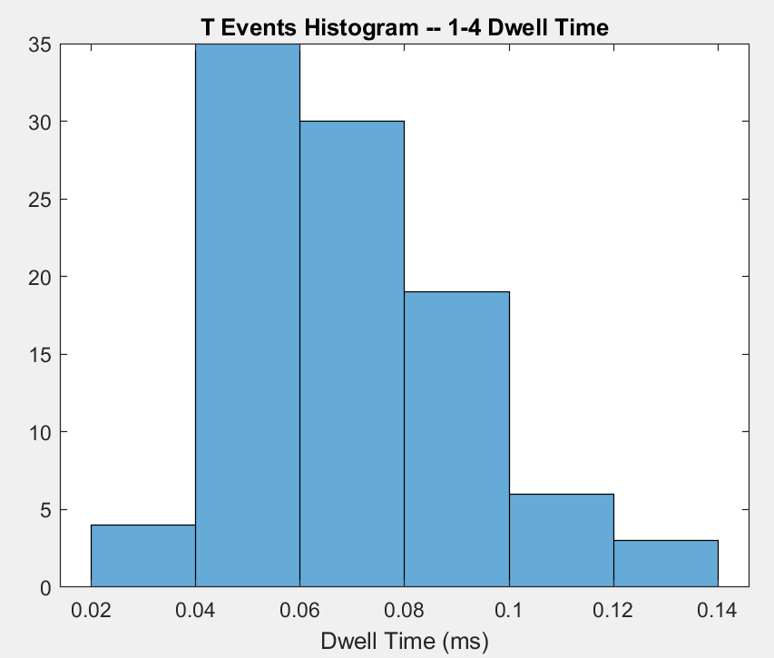
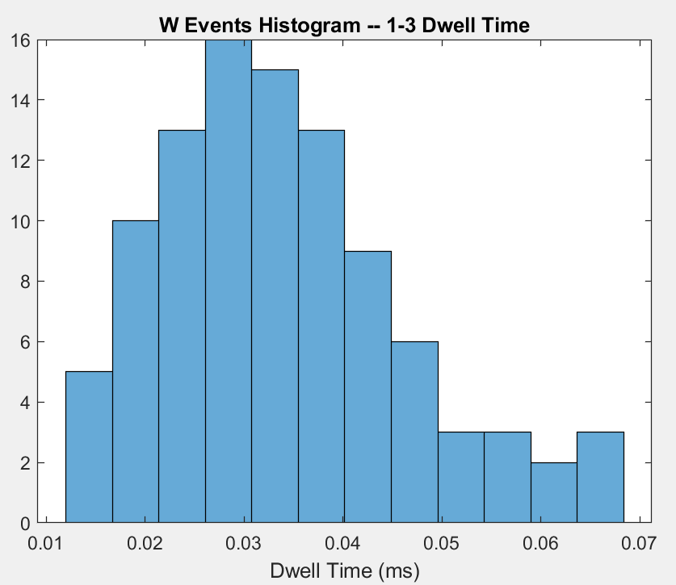
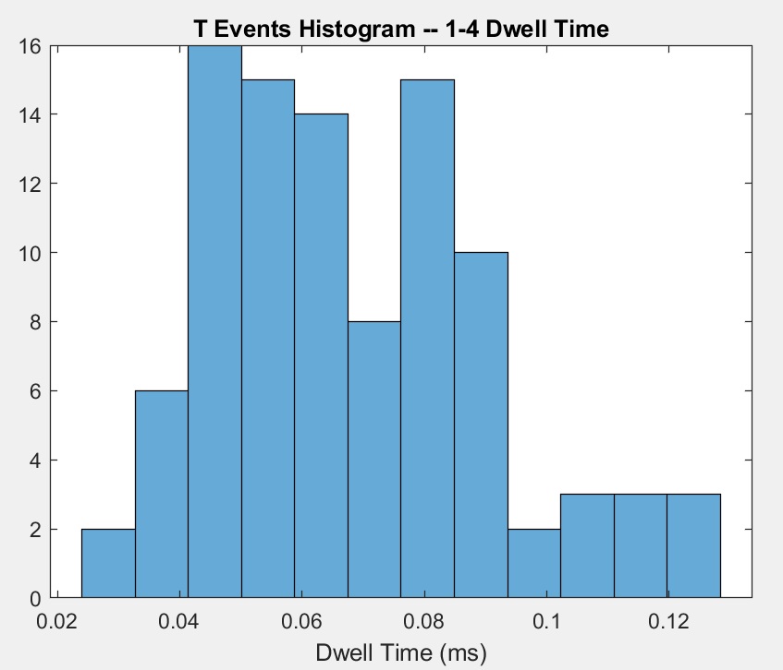
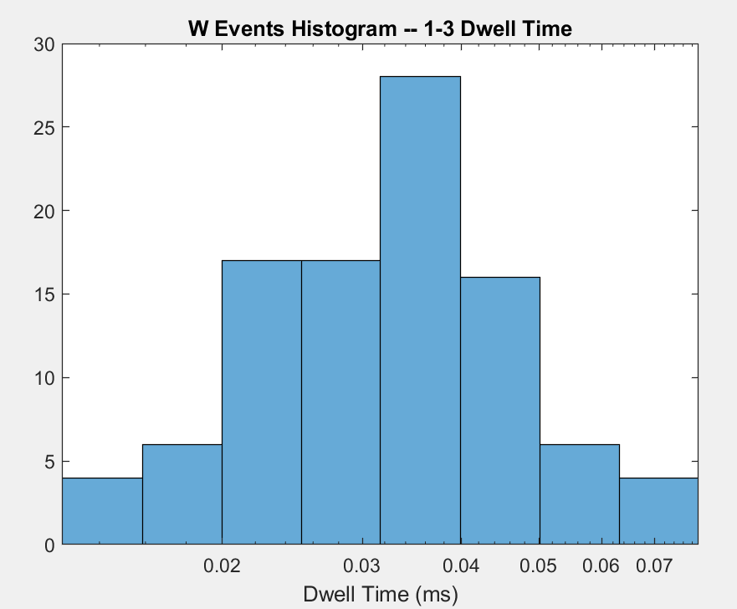
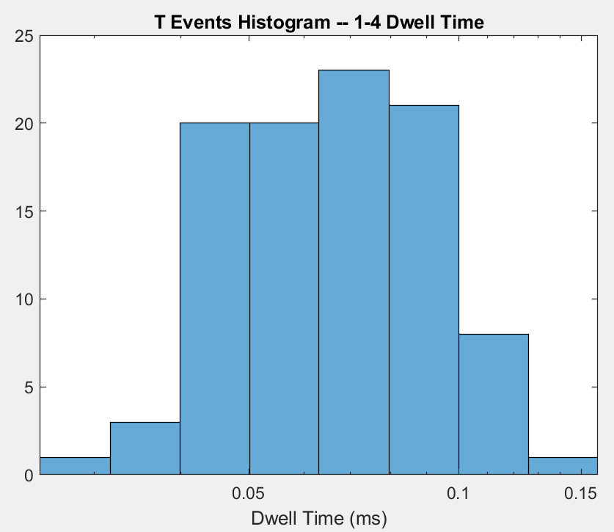
(SiNx) W event 1-3 dwell time histogram and T event 1-4 dwell time histogram
It seems like the length of time that DNA is in the SiNx pore is longer for a T event (though it could be explained that the DNA is longer since W is short DNA?)
Standard Dev: 0.0124
Standard Dev: 0.0222
(with twice the number of bins)
(with twice the number of bins)
RED: Exponential x-axis
FWHM: 0.0147
FWHM: 0.0293

Slide 5
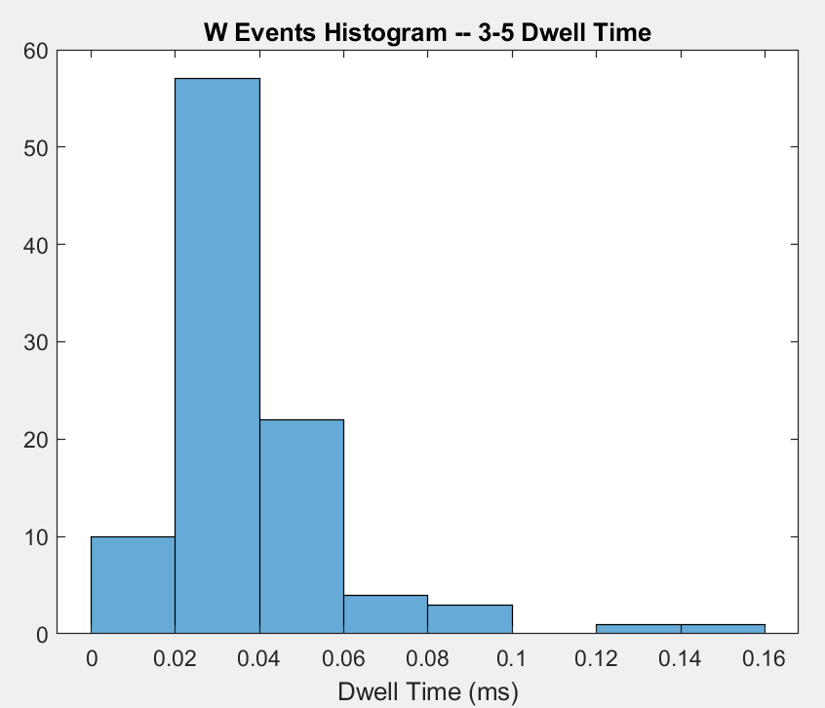
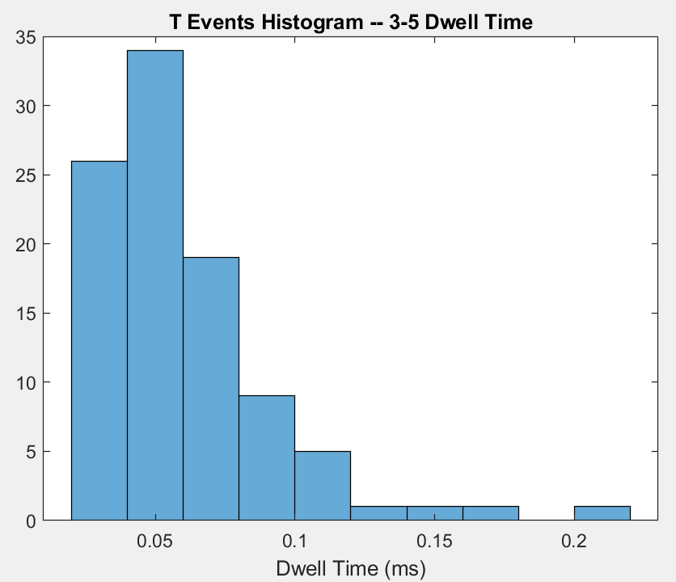
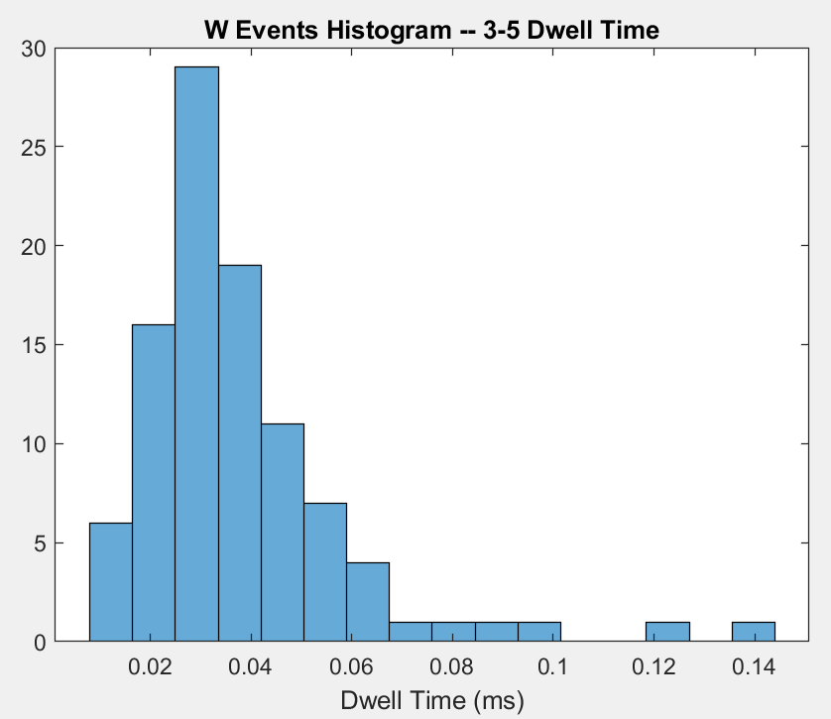
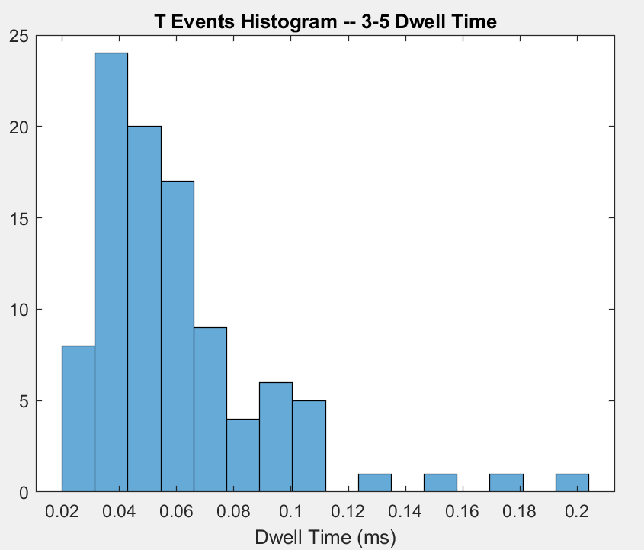
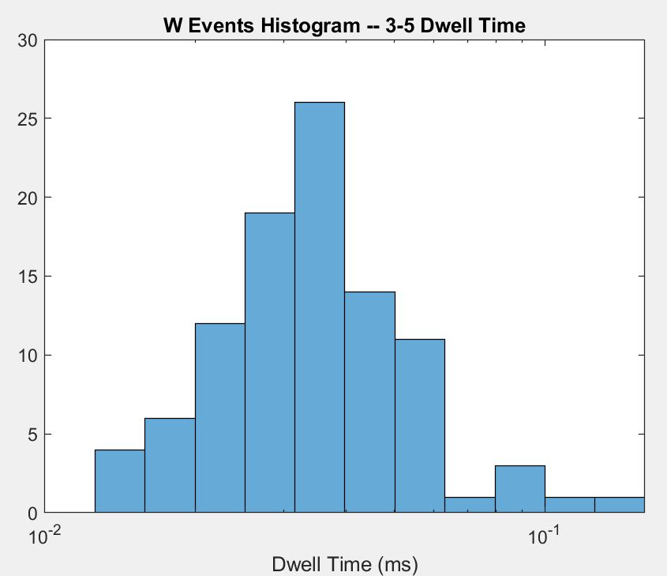
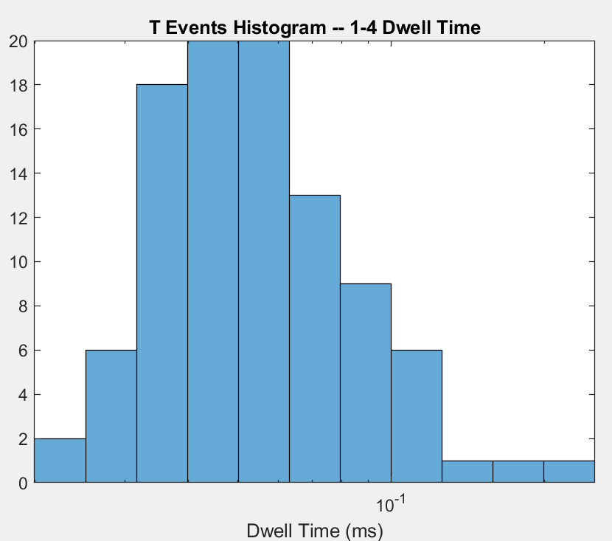
(MoS2) W event 3-5 dwell time histogram and T event 3-5 dwell time histogram
It seems like DNA stays slightly longer in MoS2 in T event? Which is probably because the length of DNA explanation from slide 3 again. Not fully sure here.
Standard Dev: 0.0208
Standard Dev: 0.0310
FWHM: 0.0082
FWHM: 0.0233

Slide 6
The last thing… about how we might have smaller spread in dwell times in MoS2 compared to SiNx (which means we’re funneling the DNA successfully and the GURU device is successfully “nanoscale preconfinement” or “lowering conformational entropy” or etc.), looking at the standard deviations next to the histograms, it seems like the MoS2 has a larger spread in dwell times in both W and T events.
This is bad news, but I’m currently trying to think of some other explanations.
Killian suggested doing FWHM (the plots in red boxes), and FWHM is smaller for MoS2 compared to SiNx

Slide 7
150 mV (Slides 8-__)

Slide 8
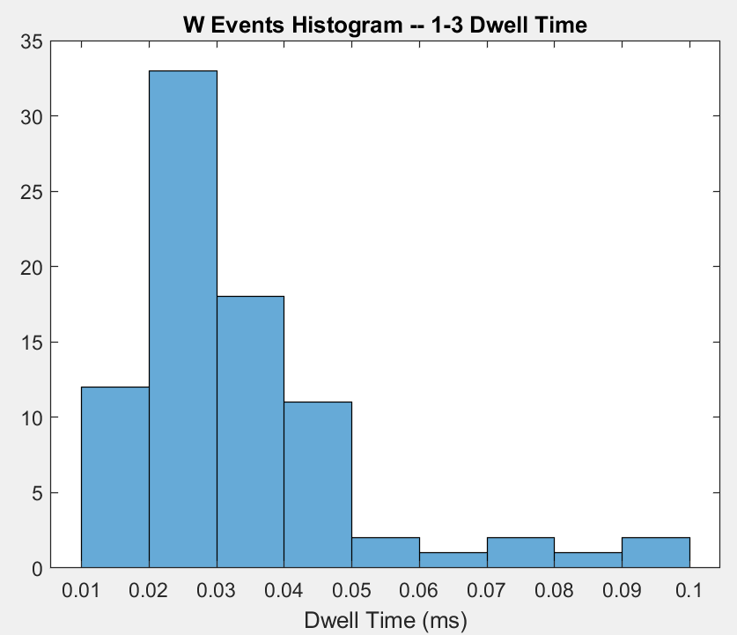
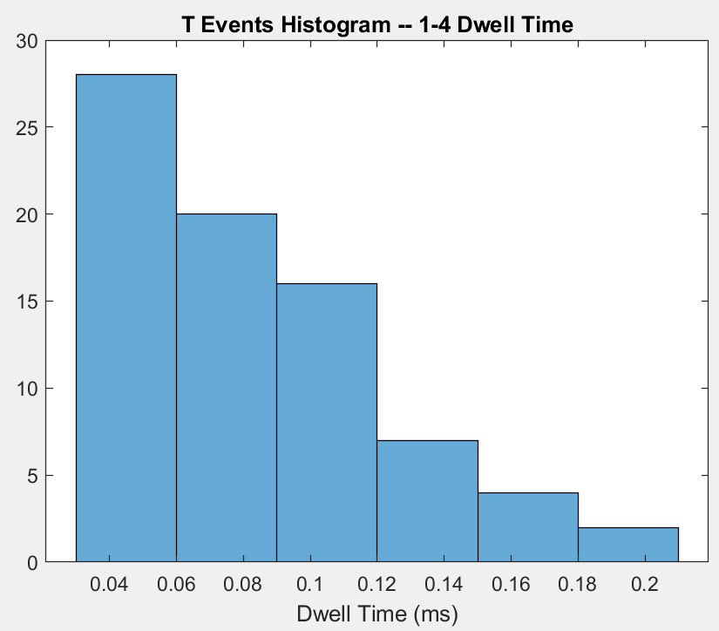
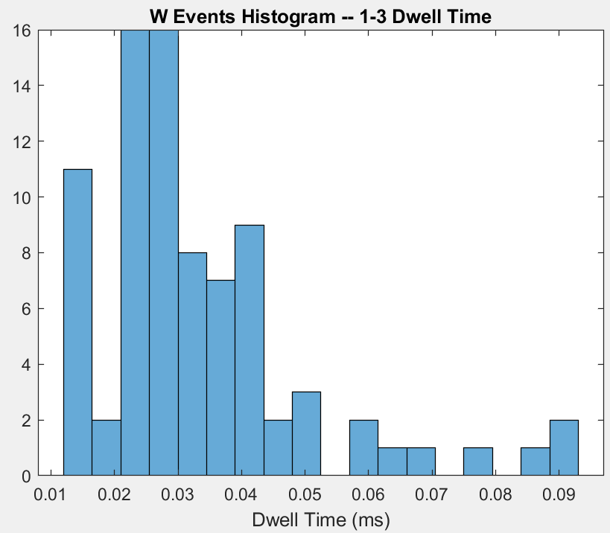
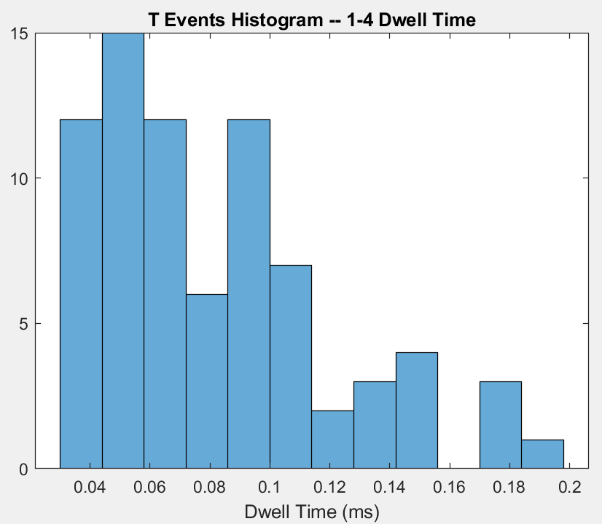
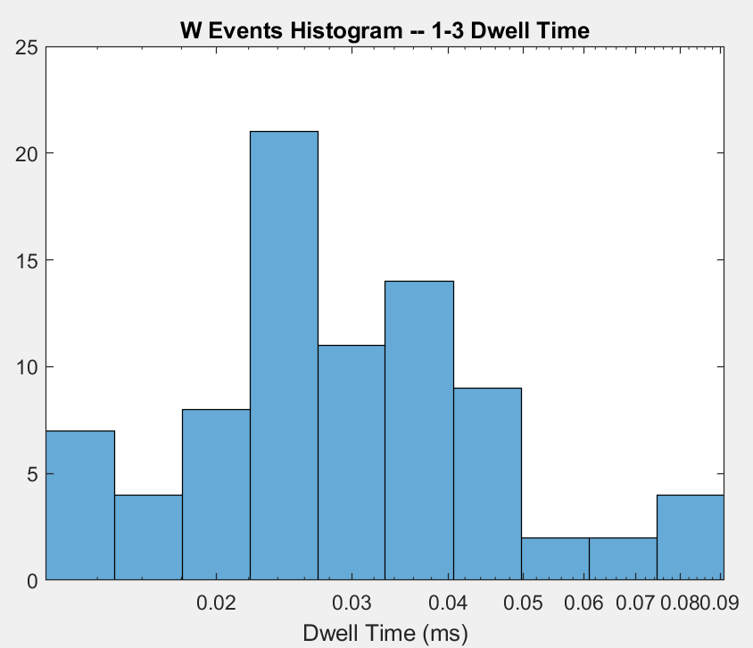
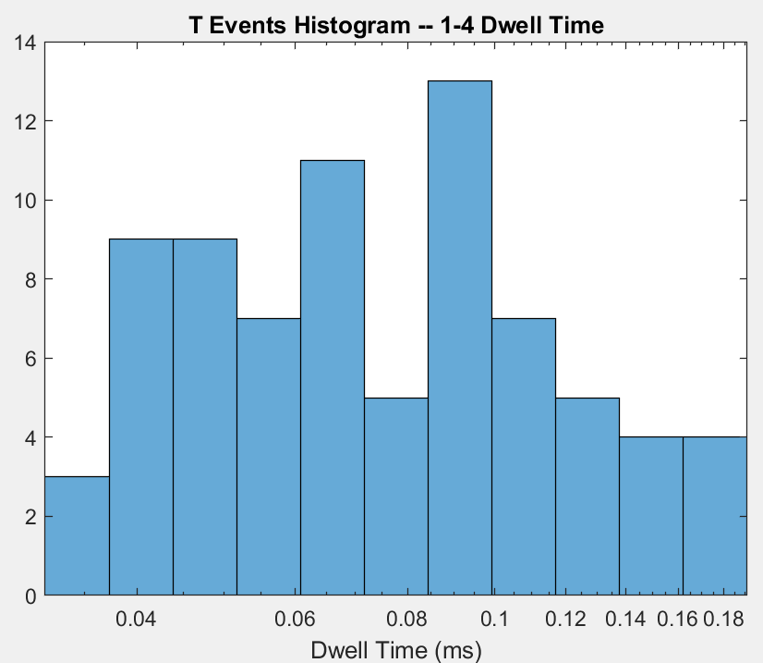
(SiNx) W event 1-3 dwell time histogram and T event 1-4 dwell time histogram
It seems like the length of time that DNA is in the SiNx pore is longer for a T event (though it could be explained that the DNA is longer since W is short DNA?)
Standard Dev: 0.0168
Standard Dev: 0.0389
(with twice the number of bins)
(with twice the number of bins)
RED: Exponential x-axis
FWHM: 0.0061
FWHM: 0.0555

Slide 9
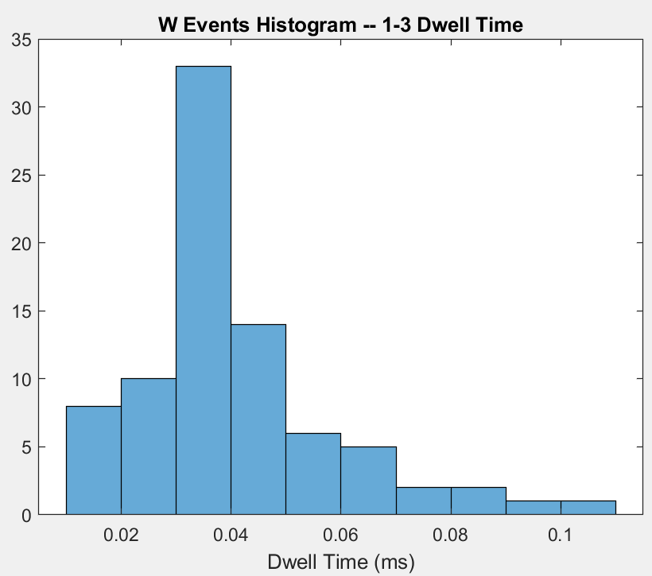
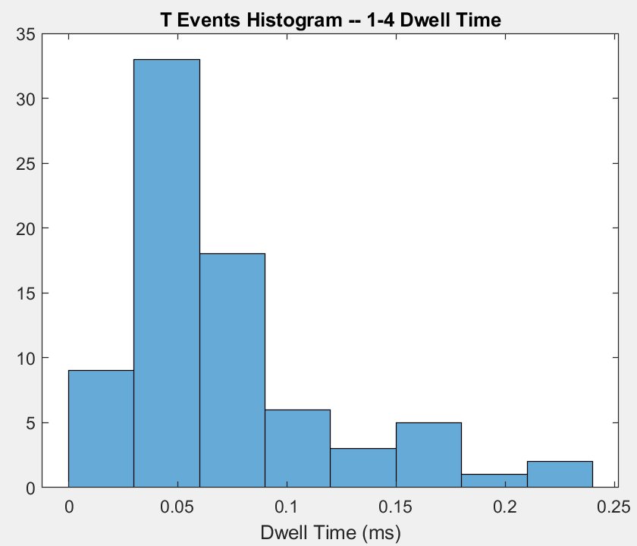
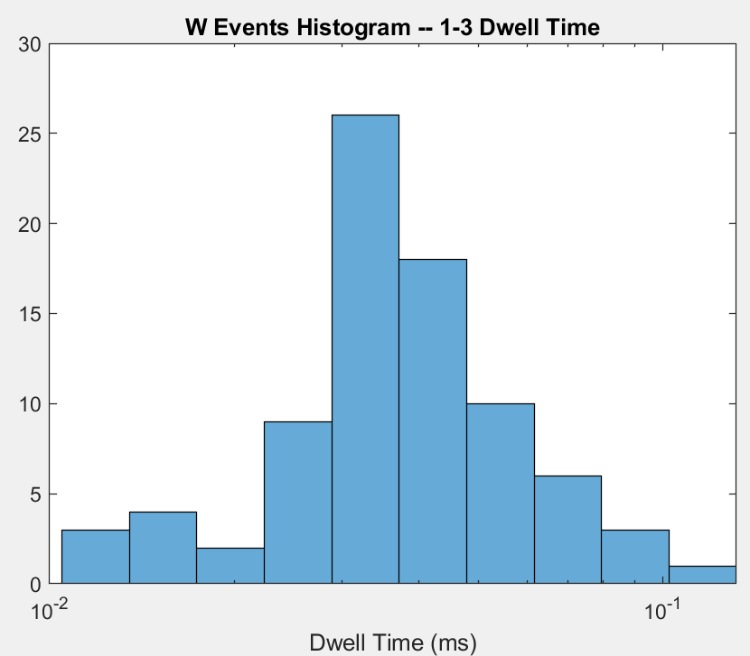
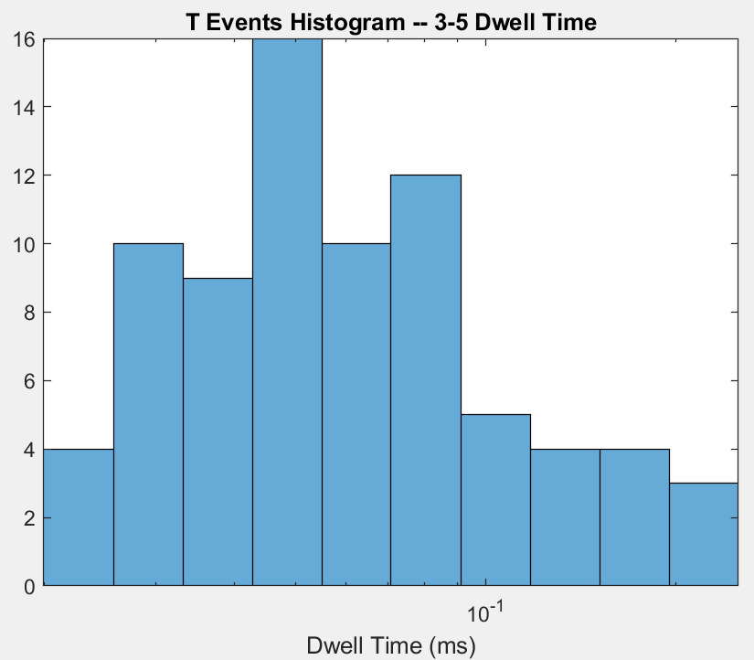
(MoS2) W event 3-5 dwell time histogram and T event 3-5 dwell time histogram
It seems like DNA stays slightly longer in MoS2 in T event? Which is probably because the length of DNA explanation from slide 3 again. Not fully sure here.
Standard Dev: 0.0179
Standard Dev: 0.0476
FWHM: 0
FWHM: 0.0479

